Slide 1
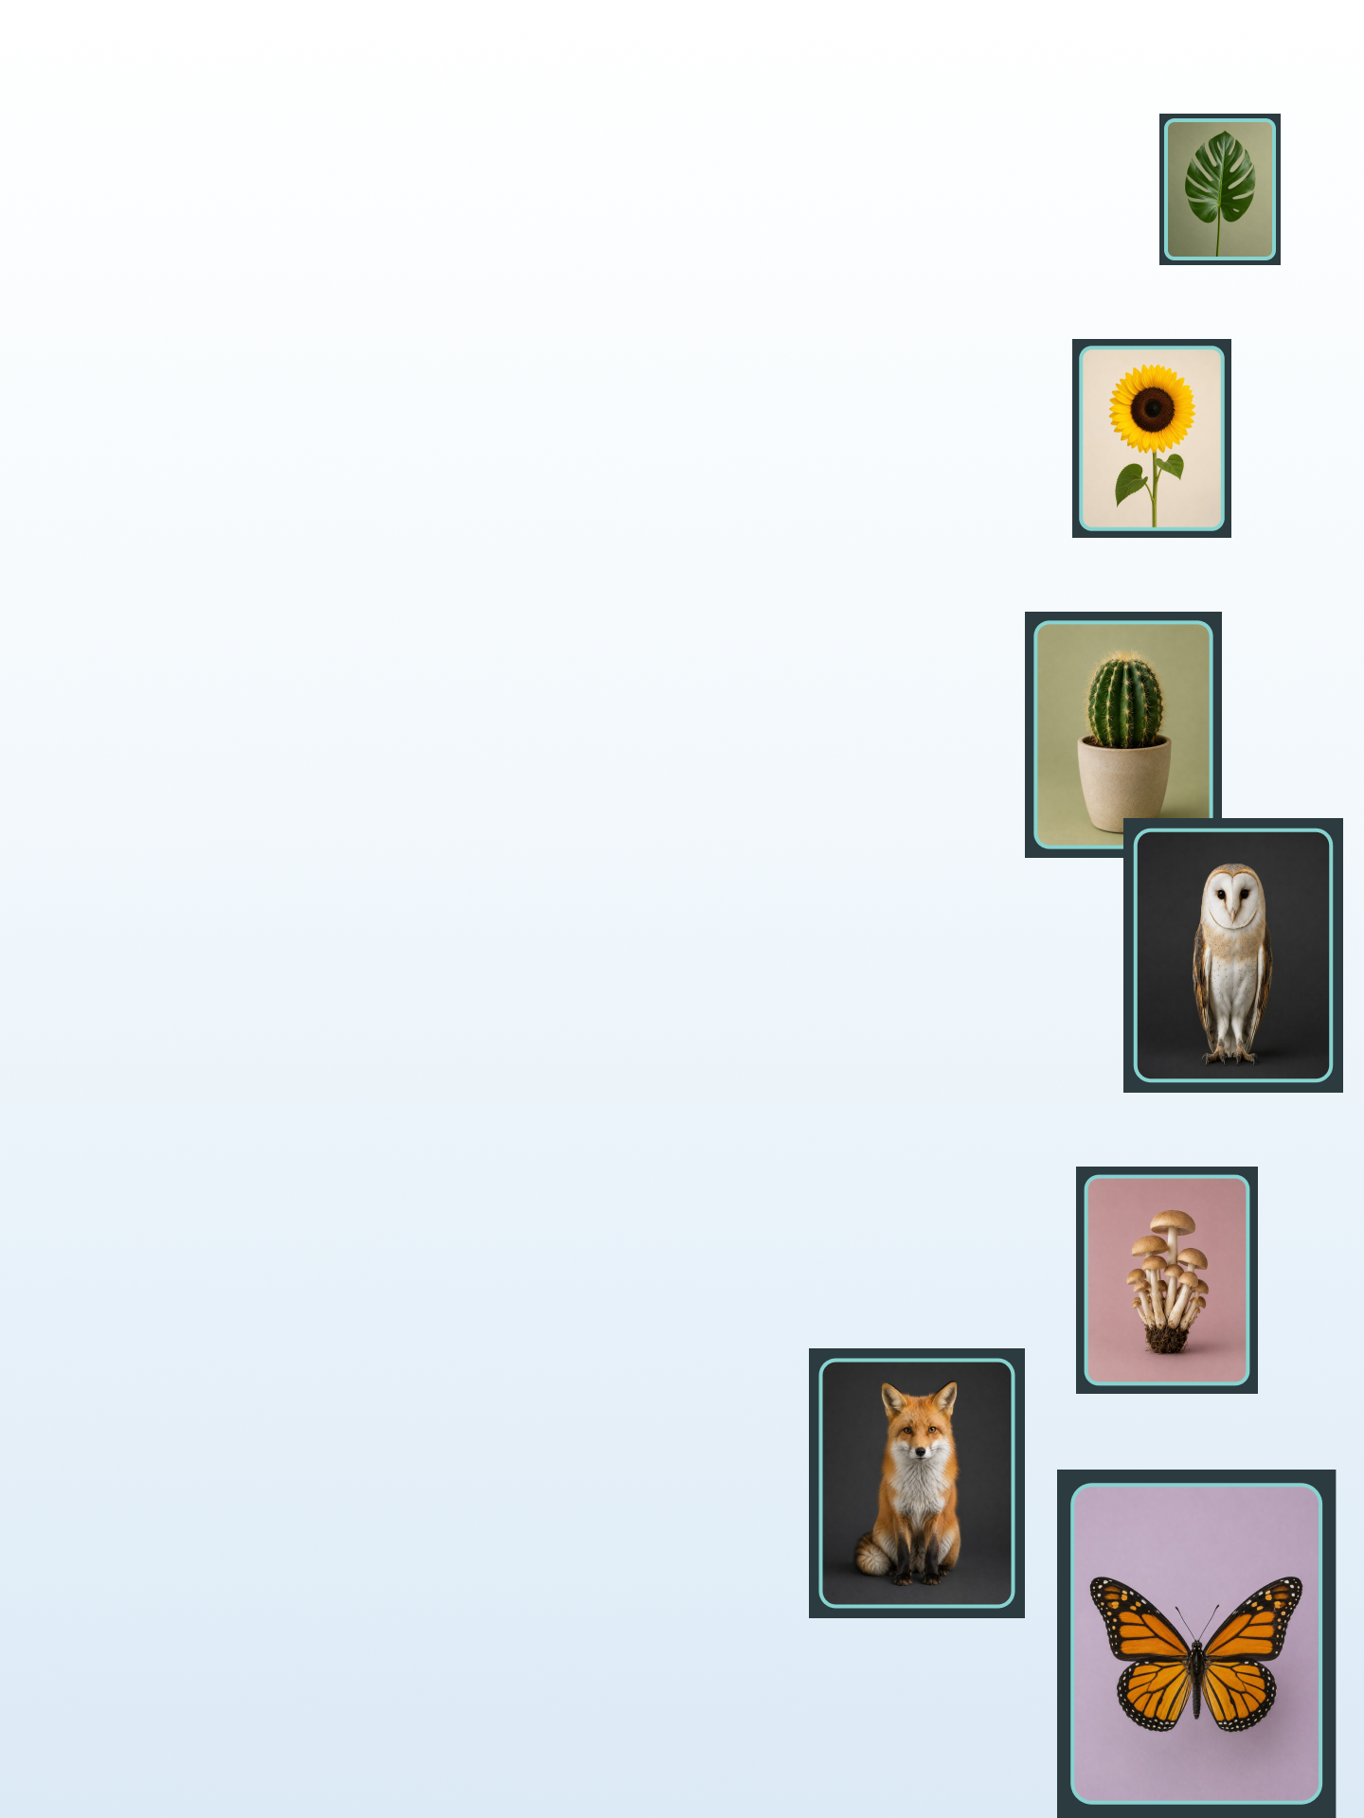

Compositions Challenge Playbook
Fun, easy ways to create and connect as a group.
A turnkey kit for campus group and club leaders.

Slide 2
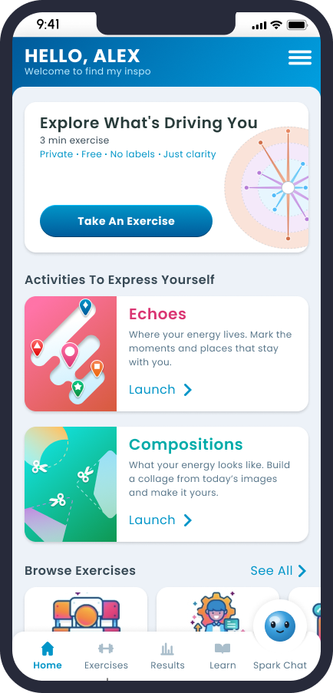
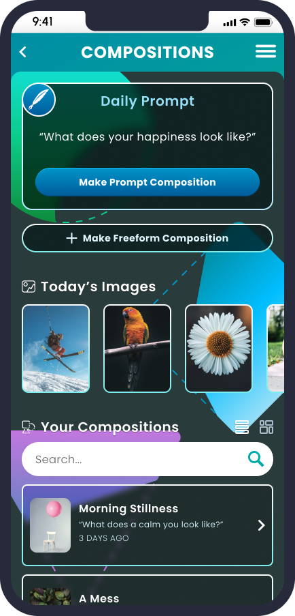
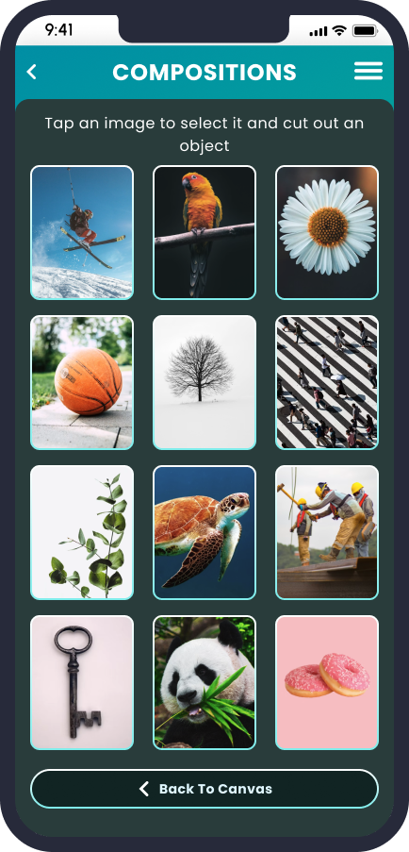
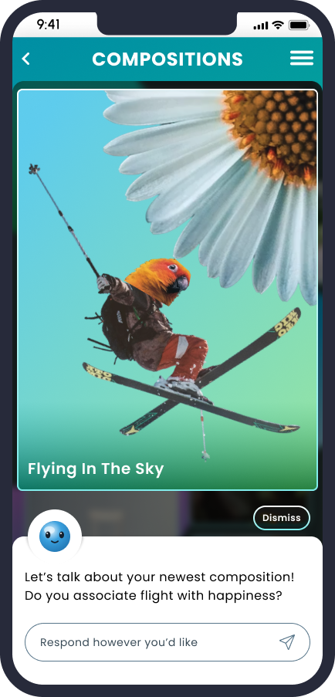

First, get your group on the app
Everyone needs the Find My inspo app to take part.
Sign up once, then run any challenge.
1
Download Find My inspo
from the App Store or Google Play.
2
Sign up with your school email
so the app knows you belong to your campus.
3
Connect to your school
this unlocks Compositions and ties your group to campus.

Slide 3
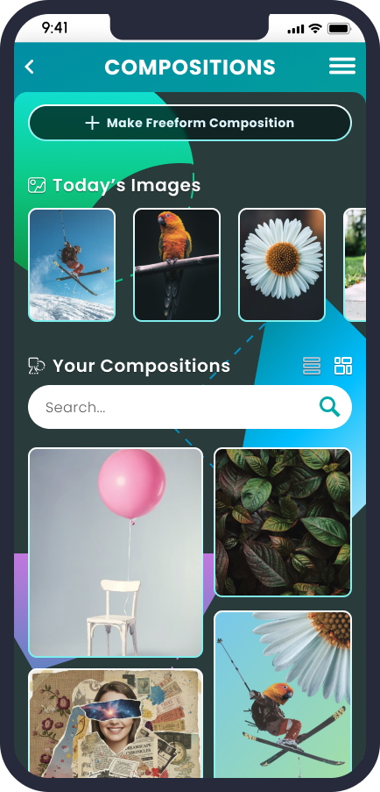
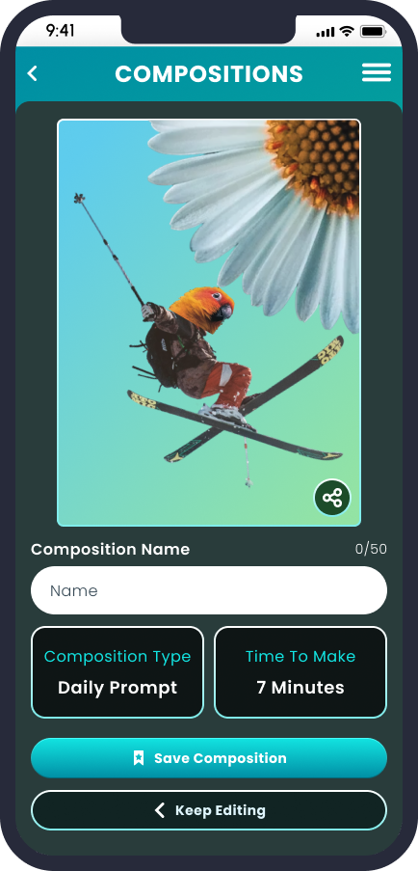
How to run any challenge
The app does the hard part: it hands everyone the same prompt and images each day.
1
2
3
Pick a day
Create & share
Celebrate
The app delivers that day’s prompt and the same 12 images to everyone. You just pick when your group plays.
Everyone makes their own take from the same 12 images and shares it. That’s the whole activity.
Feature a favorite, build a gallery, or draw a winner from everyone who shared. No judging needed.

Slide 4








TEAM CHALLENGE: Create together
Everyone works from the same daily prompt and 12 images. Share your take.
Daily Drop
Everyone does today's Compositions prompt and shares it. A simple daily ritual for your group.
Winner: Everyone who shares enters the draw.
Streak Week
Do the daily Composition and share every day for a week straight. The app's daily cadence and random image sets do the work for you!
Winner Everyone who keeps the streak enters the draw.
Same 12, Wild Takes
Same Compositions prompt, same 12 images, wildly different results. Whoever makes the most creative, hilarious, or unexpected take wins.
Winner A leader featured pick, or a light reaction vote.
Guess the Prompt
Share your takes without naming the prompt. Others guess it from the range of results. Shows how differently everyone reads the same thing.
Winner Most correct guesses, or a draw.

Slide 5





TEAM CHALLENGE: Show it off
Sharing is the point. Celebrate what everyone makes.
Group Gallery
Collect everyone's take on today's prompt into one wall: projected, posted, or printed.
Winner No contest, everyone who shares is in the gallery.
Feature Takeover
A different group gets the campus account spotlight each day for their takes on the daily Composition prompt challenge.
Winner A leader or Student Life featured pick.
Featured Take
A leader spotlights one member's creation each day. Rotating shine, zero judging pressure.
Winner The leader's featured pick.
Campus Mosaic
On a chosen day, everyone shares their Composition to combine into one big collective piece for an event or screen.
Winner No contest, every share is part of it.

Slide 6
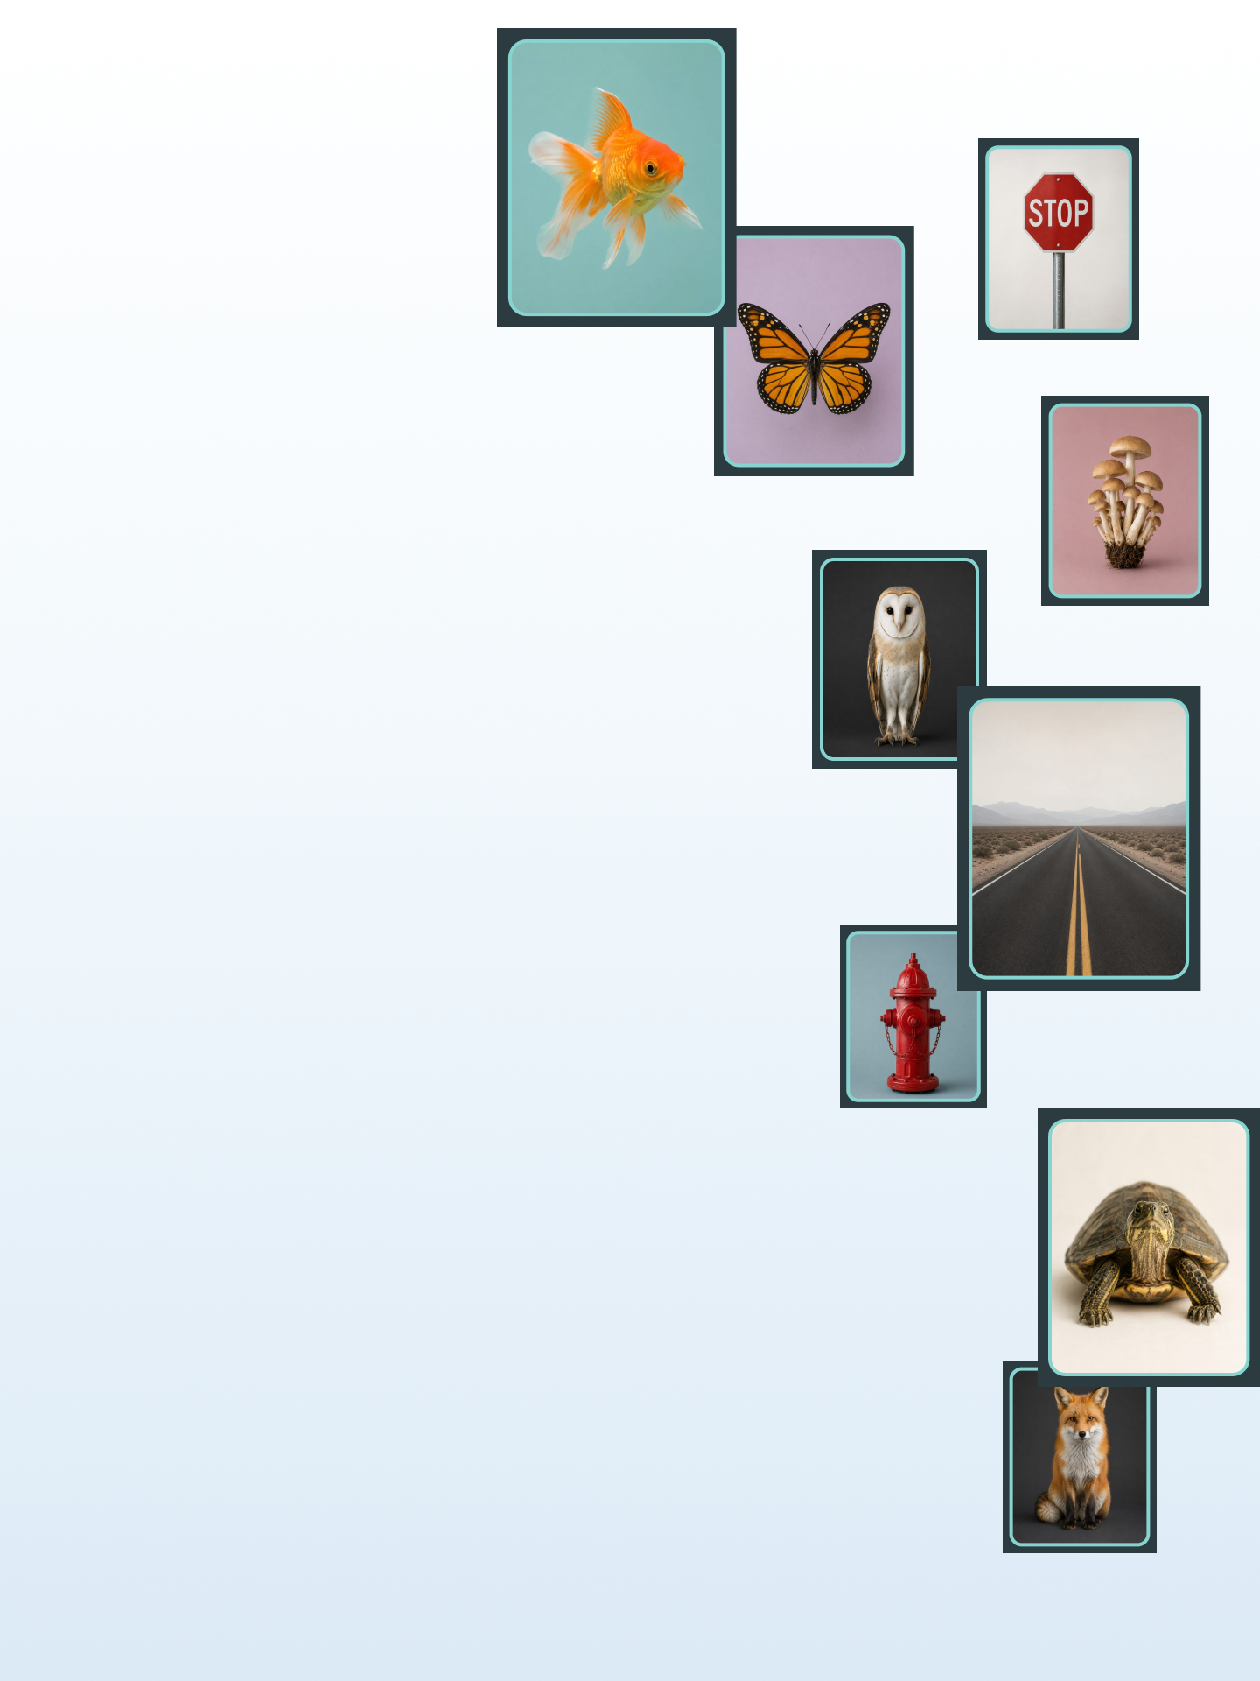
Prize ideas that reward & encourage engagement
Prizes are defined and funded by each school. A few crowd-pleasers:
Pizza party or a catered study break
Spirit gear or campus swag
Reserved seating or front-of-line dining passes
A shout-out from a dean, coach, or Student Life
Gift cards (campus store, dining, coffee or boba)
Free event or game tickets
A trophy or banner for bragging rights
Custom Find My inspo Spark stickers
Now go make something together.

