Slide 1
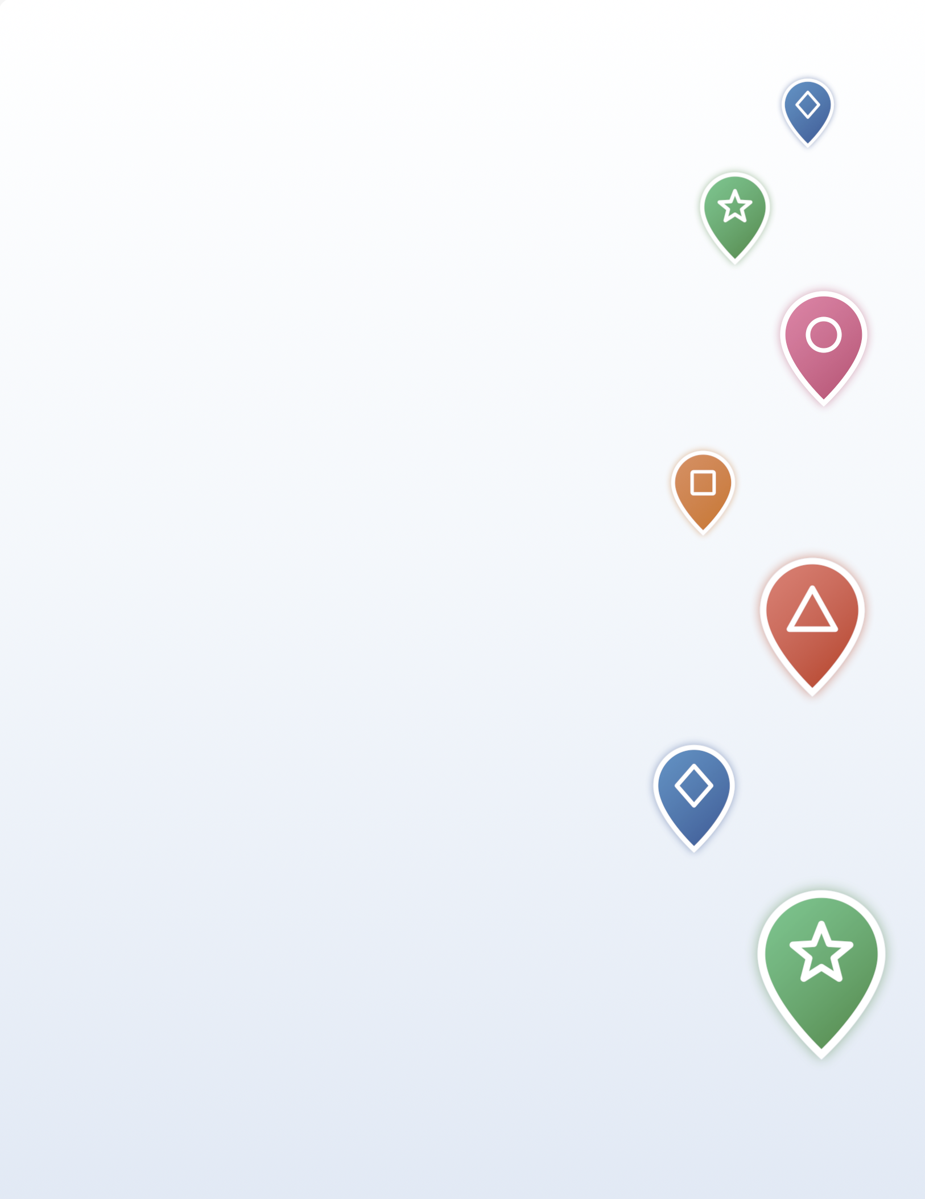

Echoes Challenge Playbook
Fun, easy ways to bring your group together on campus.
A turnkey kit for campus group and club leaders.

Slide 2
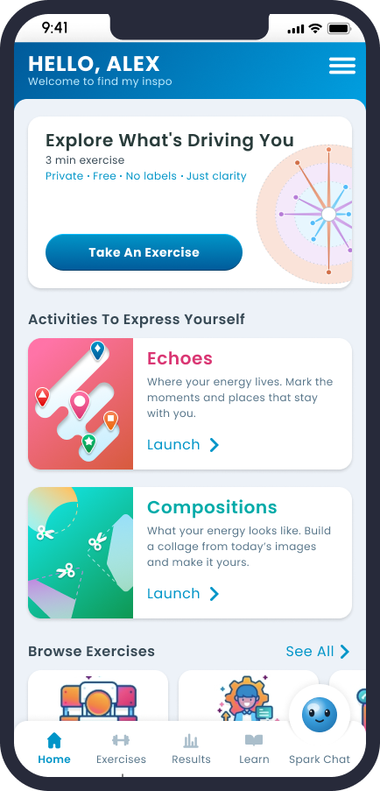
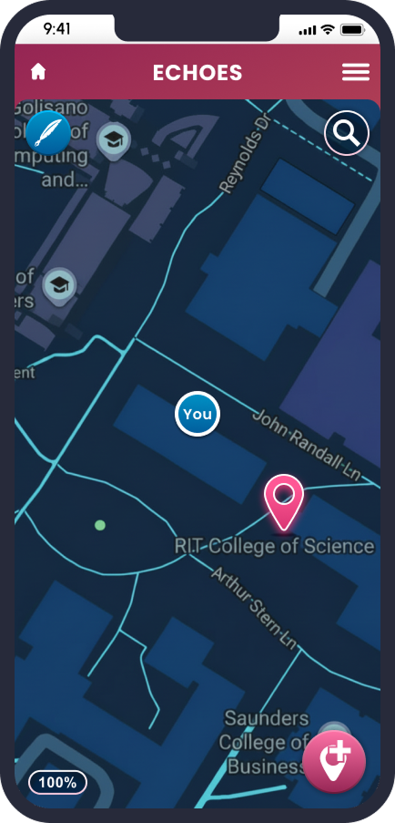
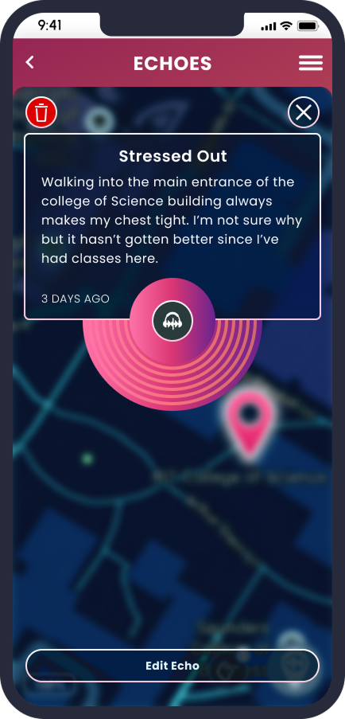
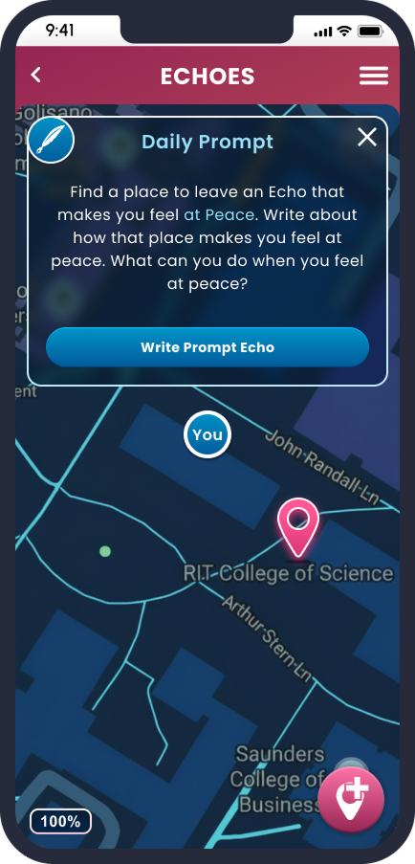

First, get your group on the app
Everyone needs the Find My inspo app to take part.
Sign up once, then run any challenge.
1
Download Find My inspo
from the App Store or Google Play.
2
Sign up with your school email
so the app knows you belong to your campus.
3
Connect to your school
this unlocks Echoes and ties your group to campus.

Slide 3
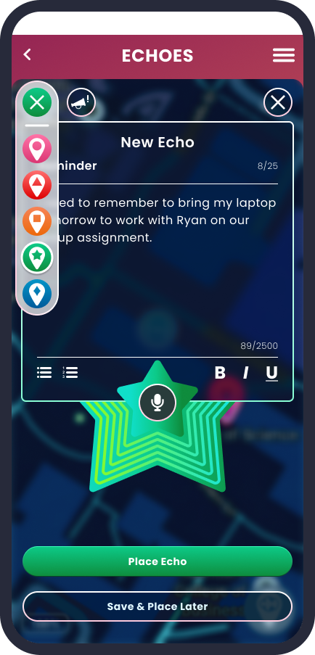
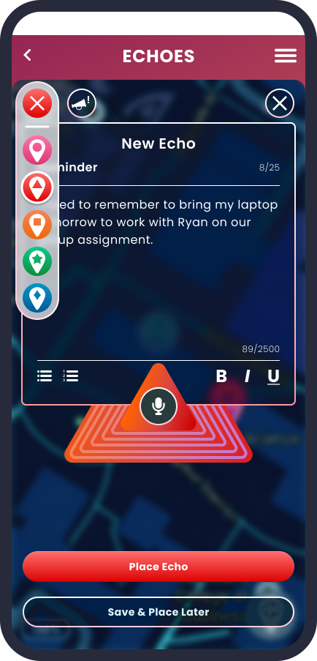
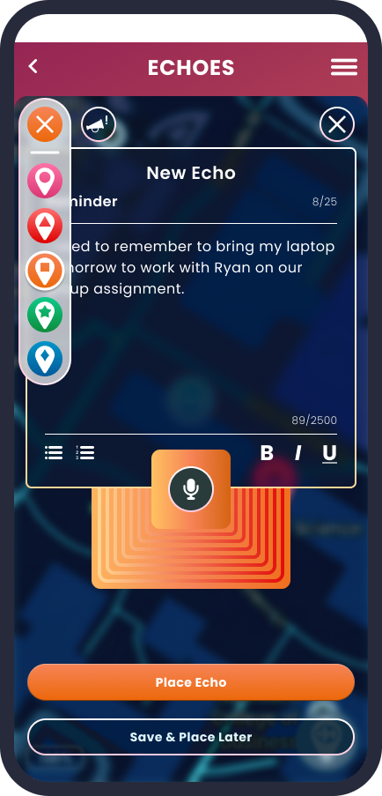
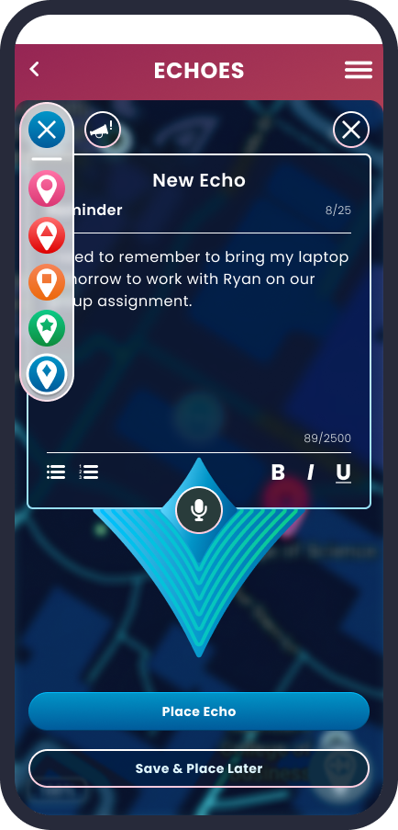
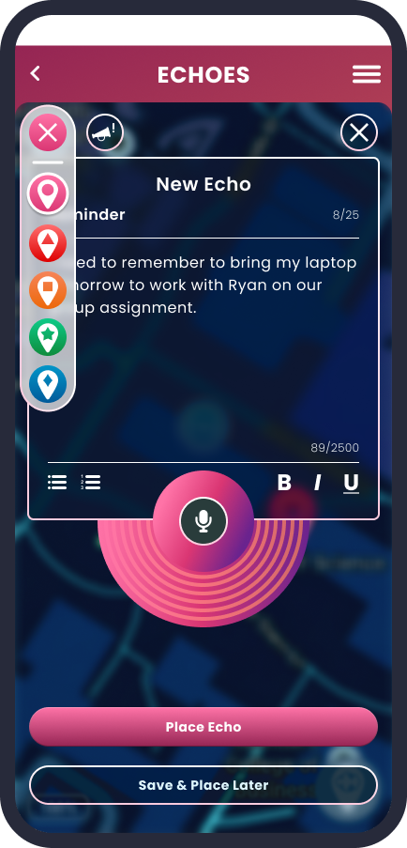
How to run any challenge
Three easy steps. No refereeing required.
1
2
3
Set it up
Prove it
Pick a winner
Pick a challenge, a spot, and a time window.
A group photo or a screenshot, sent to one place: an album, a form, or a hashtag.
By a simple count, or a random draw. A draw is easiest and totally fair.

Slide 4





TEAM CHALLENGE: Complete the list
Students check their own screen. Verify with a screenshot.
Pin Bingo
Bingo Card
A bingo card of locations like a place you feel calm, where you made a friend, best study spot, your go-to when you’re stressed, etc. Fill squares by pinning the places they describe.
Winner Most squares by the deadline, or a random draw.
Streak Challenge
Pin at least one spot a day for a set stretch, like a week or finals week. Students choose the locations themselves and take a screenshot of their campus map by the deadline.
Winner Everyone who keeps the streak enters the draw.
Pin Passport
Give students a short list of campus categories to collect, like a dining spot, a study spot, a green space, a spirit spot, and a support spot. They fill the passport by pinning one of each.
Winner Finish the passport to enter the draw.
Scavenger Clues
Post clues instead of locations, like where caffeine meets cramming or the quietest floor on campus. Students solve each one by pinning the right spot.
Winner Most clues solved, or a draw.

Slide 5
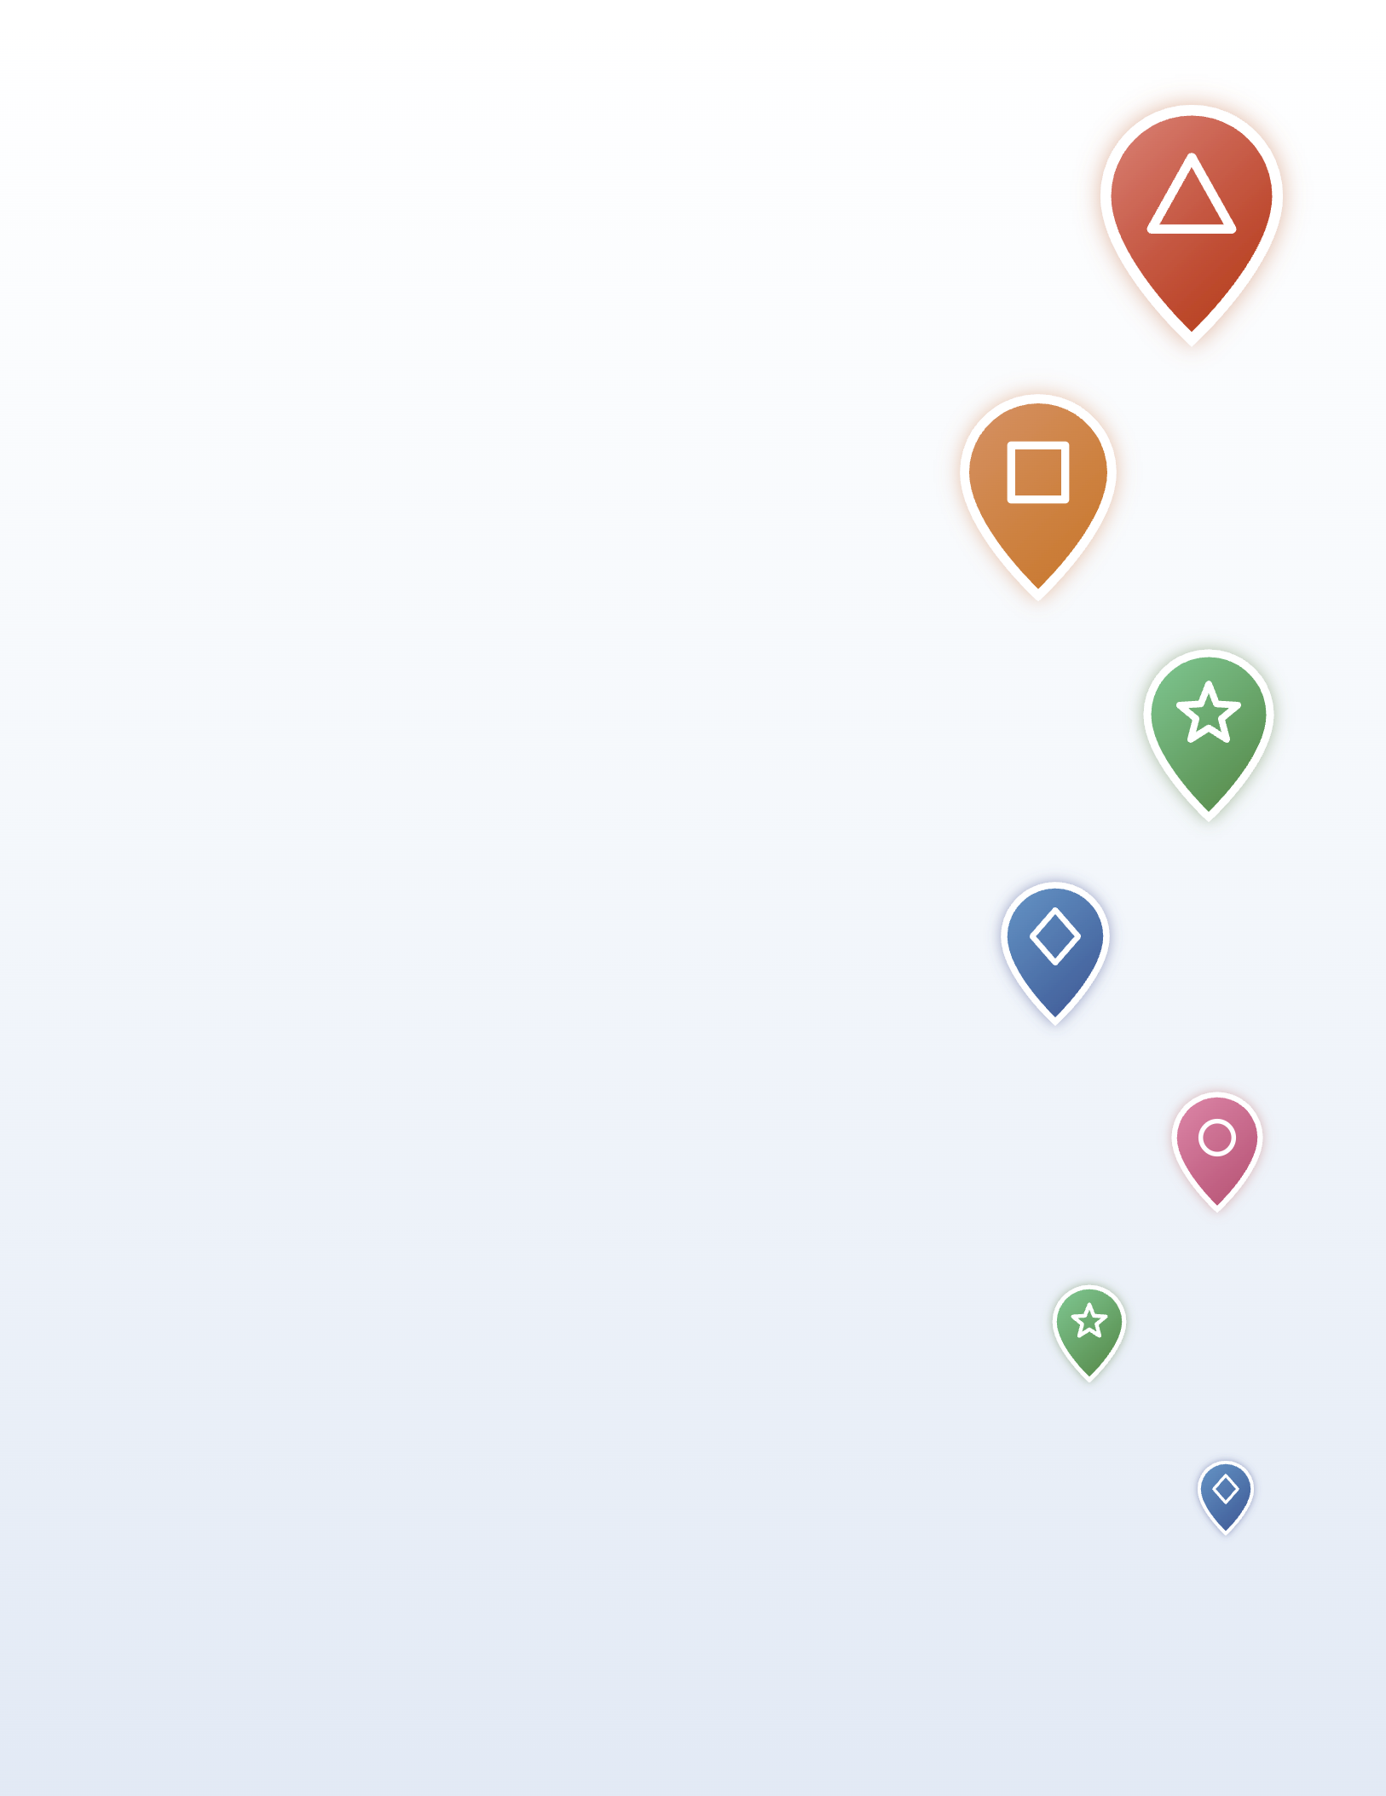





TEAM CHALLENGE: Complete the list
Students check their own screen. Verify with a screenshot.
Pin Mob
Post a spot and a short window, for example: Library steps, Thursday 7:00 to 7:15, pin it. Everyone who shows up pins the location, then the group takes one photo together.
Winner Group with the most people in the photo.
Beat the Clock
Give each group a list of five spots and a time limit. Every member has to pin all five before time runs out.
Winner First group with all members in.
Power Hour
Pick one location and a one-hour window. Every member who shows up and pins during that hour scores a point for their group.
Winner Highest turnout, verified with photo.
Pin Crawl
Set up five spots, each open for a set window across an afternoon. Groups travel together and pin at each checkpoint, snapping a group selfie at every stop.
Winner Most checkpoints reached.

Slide 6


Prize ideas that reward & encourage engagement
Prizes are defined and funded by each school. A few crowd-pleasers:
Pizza party or a catered study break
Spirit gear or campus swag
Reserved seating or front-of-line dining passes
A shout-out from a dean, coach, or Student Life
Gift cards (campus store, dining, coffee or boba)
Free event or game tickets
A trophy or banner for bragging rights
Custom Find My inspo Spark stickers
Now go claim campus.

Slide 7
